Slide 1
Discrete Logarithm
Discrete logarithms are fundamental to a number of public-key algorithms, including Diffie-Hellman key exchange and the digital signature algorithm (DSA).

Slide 2
Logarithm
2⁵ = 32 (Easy), we can rewrite this as follows;
5 = log₂(32)
3? = 129140163 (finding exponent is Difficult)
17 = log₃(129140163)
General form of Logarithm:
p^{i} = q, rewrite as follows;
i = log_{p}(q)

Slide 3
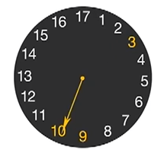
Discrete Logarithm Problem
Modular arithmetic: 46 mod 12 ≡ 10
Lets consider prime modulus such as 17 and the primitive root of 17 such as 3.
when primitive root is raised to different exponents i.e 3¹ mod 17, 3² mod 17, 3³ mod 17,……. 3¹⁶ mod 17,then the solution distributes uniformly around the clock.
NOTE: ‘α’ is said to be a primitive root of prime number ‘p’, if α¹ mod p, α² mod p, α³ mod p,….. α^{p-1} mod p are distinct.

Slide 4
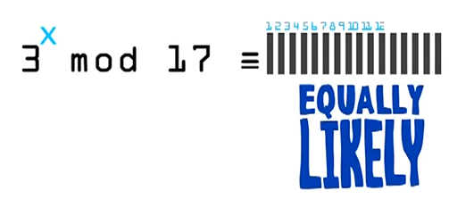
Discrete Logarithm Problem (Contd…)
Here 3 is a generator, if we raise 3 to any exponent ‘x’, then the solution is equally likely to be an integer between 0 and 17.
3²⁹ mod 17 = 12 (Easy)
3? mod 17 = 12 (Hard)
General Form:
b^{i}(mod m) = a
dlog_{b,m}(a) = i
Where ‘b’ is the primitive root of modulo ‘m’.

Slide 5
Example
Find ‘i’ in the given equation 8 = 5^{i} mod 13.
Solution:
Given;
i = dlog _{5,13} (8)
i = ?
Go with Brute force attack and try i = 1,2,3,….
When i = 3 then 5³ mod 13 = 8 (verified).
Therefore, i = 3
NOTE: consider the case when the dlog given unique values, only then we can use dlog in our algorithm.

Slide 6
How to identify whether ‘i’ is unique?
b^{i}(mod m) = a
dlog_{b,m}(a) = i
We can get an unique value of ‘i’ if ‘b’ is the primitive root of prime modulo ‘m’.

Slide 7
Primitive Roots Example -1
Find the primitive root of 7.

Slide 8
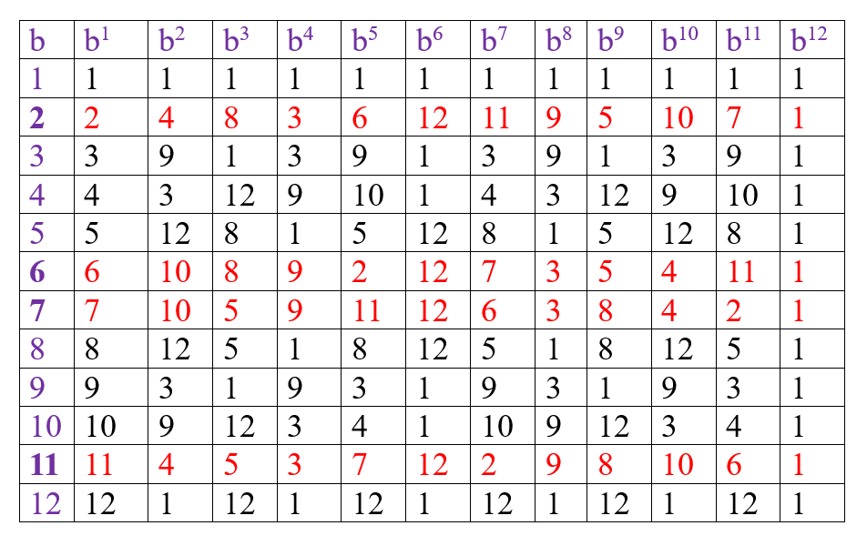
Primitive Roots Example -2
b^{i}(mod m) = a and consider m = 13
The primitive root of 13 is 2,6, 7 and 11
b¹ mod m
Unique

Slide 9
Discrete Logarithm:
If a is an arbitrary integer relatively prime to m and b and is a primitive root of m, then there exists exactly one number i such that
a = b^{i} (mod m)
the number i is then called the discrete logarithm of a with respect to the base b modulo m and it is denoted by
i = dlog_{b,m}(a)
Primitive Root
If b is a primitive root of mod m where m is a prime number then b¹ mod m, b² mod m, b³ mod m .. b^{m-1} mod m are (unique) distinct values

